Slide 1


Data center reporting and analysis using Power BI
Kurt van Hoecke Stijn Callebaut
Inovativ Inovativ
@bunkco @StijnCa
CDM MVP

Slide 2
Session objectives
Position Power BI added value
Provide an overview of the new Power BI experience
Provide an end-to-end Private Cloud example
Demonstrate power of Power BI for business

Slide 3
events
data
intelligence
people
insights
action
?
Power BI

Slide 4


Microsoft Business Intelligence and Analytics
DELIVERY AND CONSUMPTION
Power BI
Dashboards
Reports
Excel
Mobile
APIs
BUSINESS ANALYST TOOLS
IT PRO AND DEVELOPMENT TOOLS
Excel
SQL Server Analysis Services
DATA
SQL Server Reporting Services
Power BI Designer
SQL Server Data Tools
Relational
Non-relational
NoSQL
ETL
Streaming
SaaS Services
Public
Machine Learning
{ }
10101
01010
00100

Slide 5
Tools & services overview

Slide 6
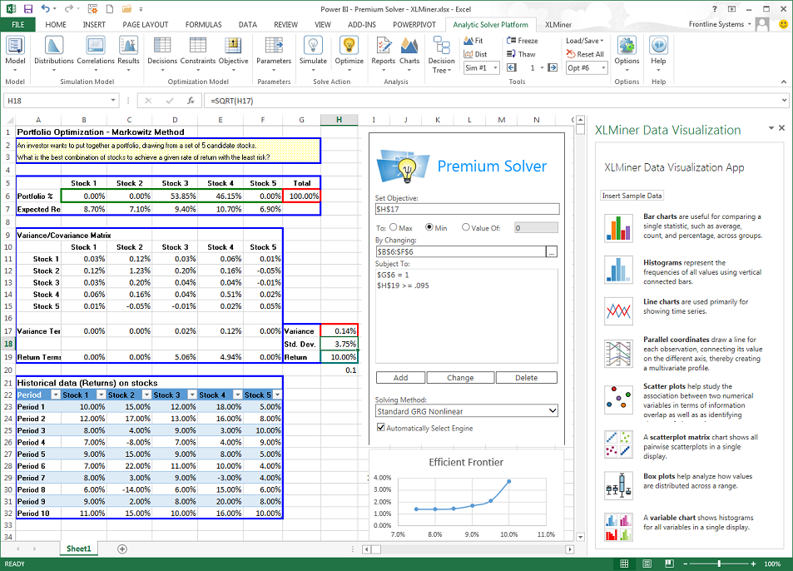
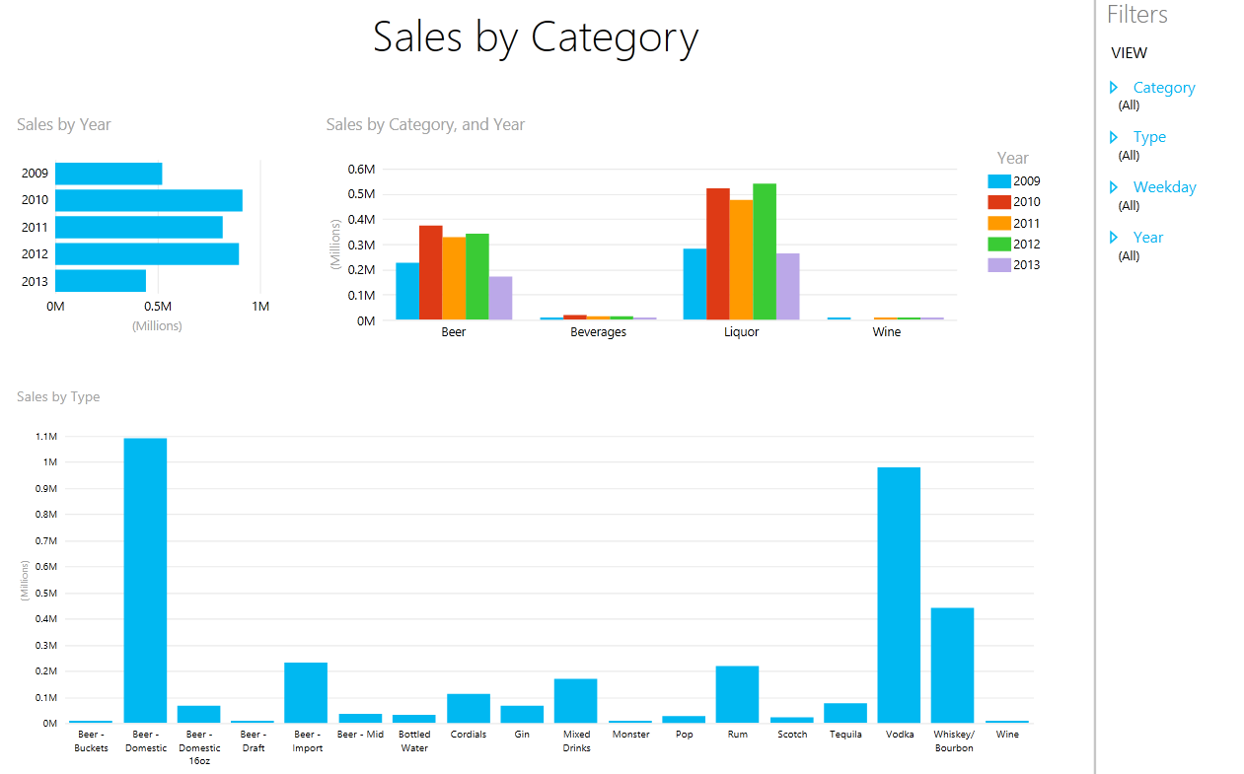
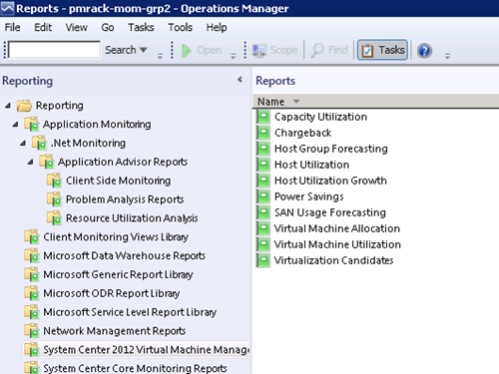
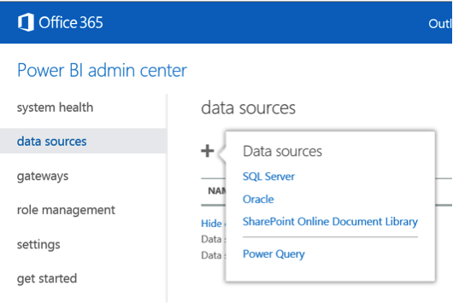
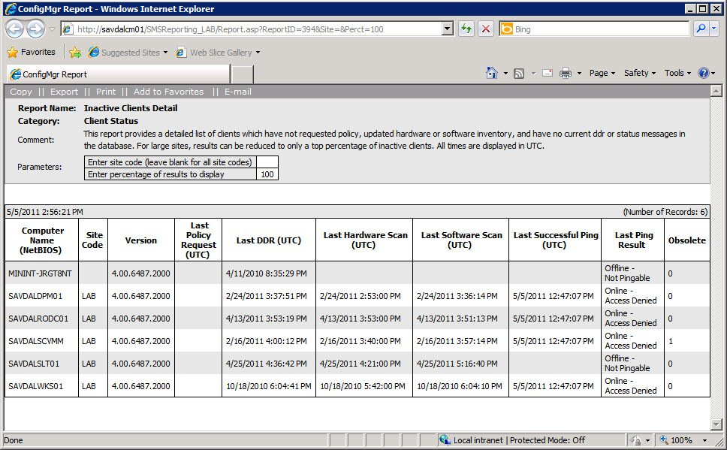
Reporting landscape

Slide 7
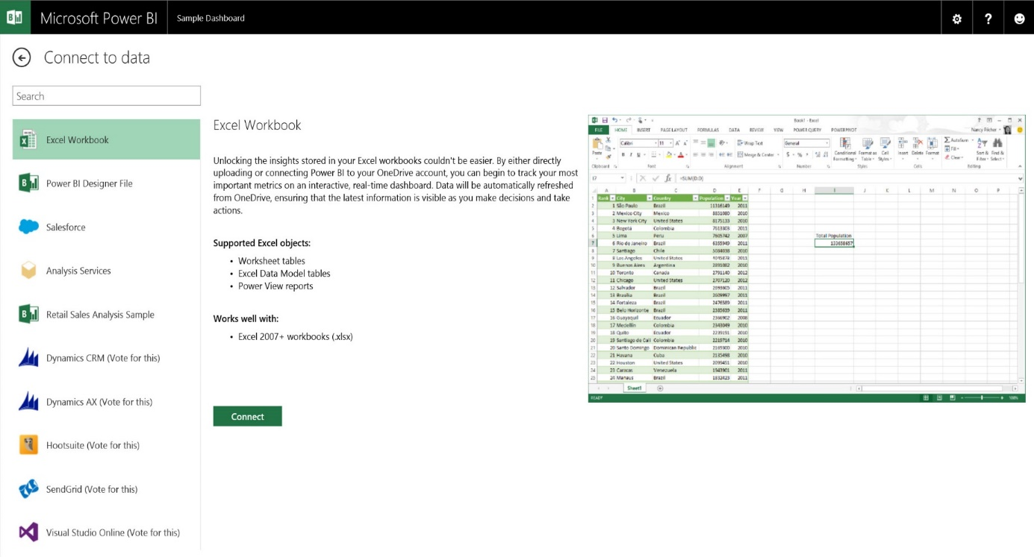
Unlock your Excel data Publish your Excel workbooks to Power BI
Analyze your data in the familiar Excel environment
Share Excel data, analysis, and reports in Power BI
Migration path from “old experience” to Power BI

Slide 8
Power BI - the new experience

Slide 9
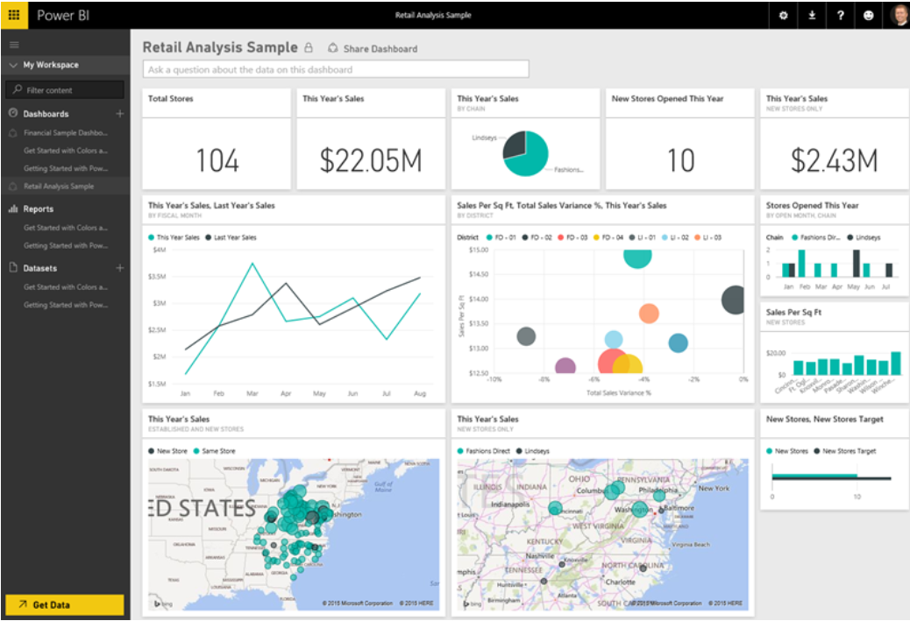
Create Power BI Content Visual Data Exploration & Interactive Reporting
Power BI
Microsoft Power BI is a collection of online services and features
Visually explore your data and create interactive reports
Effortlessly publish and share with users of Power BI
2 experiences available
The new experience - Power BI
The previous experience - Power BI for Office 365.

Slide 10
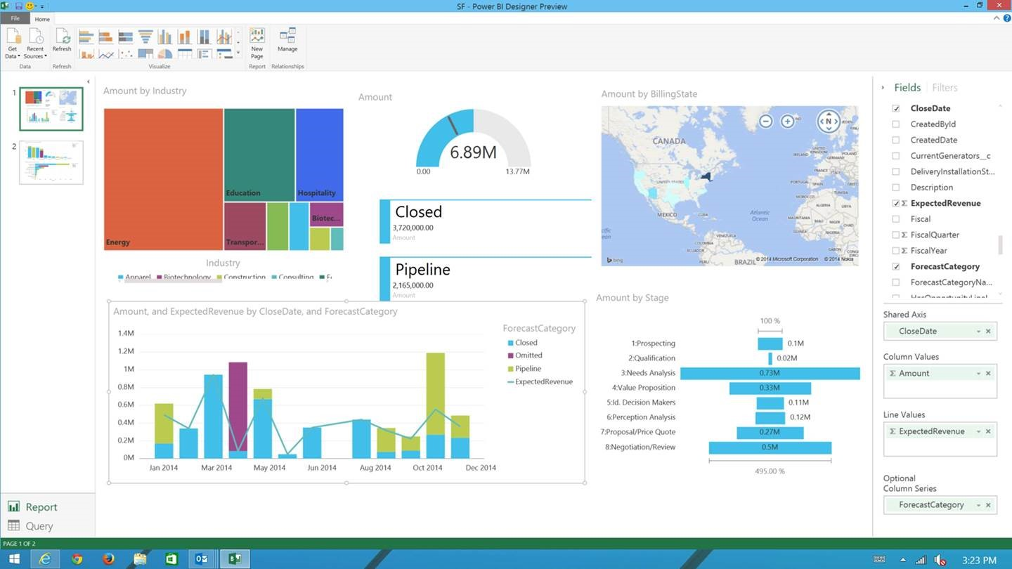
Create Power BI Content Visual Data Exploration & Interactive Reporting
Power BI Designer
Part of the new experience.
Free download
Desktop companion for the Power BI service
Visually explore your data and create interactive reports
Effortlessly publish and share with users of Power BI

Slide 11
DEMO

Slide 12













Data experience from different sources Any data, any way, anywhere
Data Sources
MICROSOFT CLOUD
Analyze your data in the PowerBI environment
Share data, analysis, and reports in Power BI
Connect live to Excel workbooks in OneDrive
NON-MICROSOFT CLOUD
ON-PREMISE DATA

Slide 13
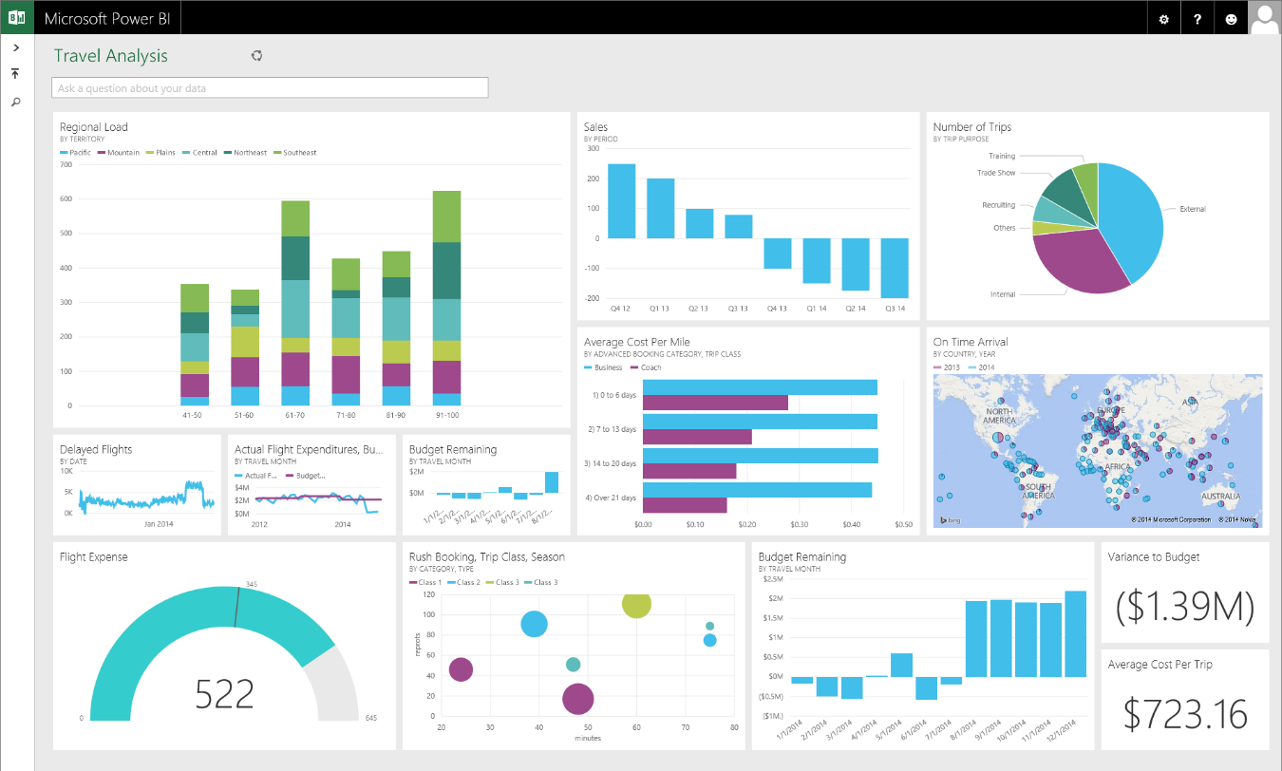
All data in a single pane of glass Live dashboards and interactive reports
Data visualization
Analyze your data in the familiar Excel environment
Share Excel data, analysis, and reports in Power BI
Connect live to Excel workbooks in OneDrive

Slide 14
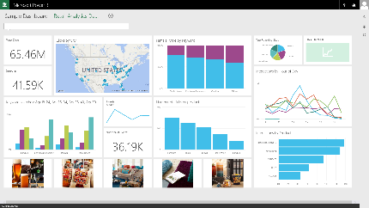
Connect to on-premises data Live Query & Scheduled Data Refresh
Data connect
Live Power BI reports & dashboards
Faster time to insight with a hybrid BI solution
Manage and secure data on-premises with SQL Server Analysis Services
Optimized query performance for interactive exploration
Scheduled refresh of data stored in Power BI
Live Query
Scheduled Refresh
Cloud
On-premises
SQL Server Analysis Services
Data Source

Slide 15
Let’s start – demo time! Using Power BI on private cloud data

Slide 16
The demo elements
Request: Gather business requirements
Translation: Creation of the data set
Visualization: Power BI in action
Hand-over: Share the solution

Slide 17

Request: Gather business requirements
Notes:
Demo

Slide 18

Translation: Creation of the data set
Notes:
Demo

Slide 19

Visualization: Power BI in action
Notes:
Demo

Slide 20

Hand-over: Share the solution
Notes:
Demo

Slide 21
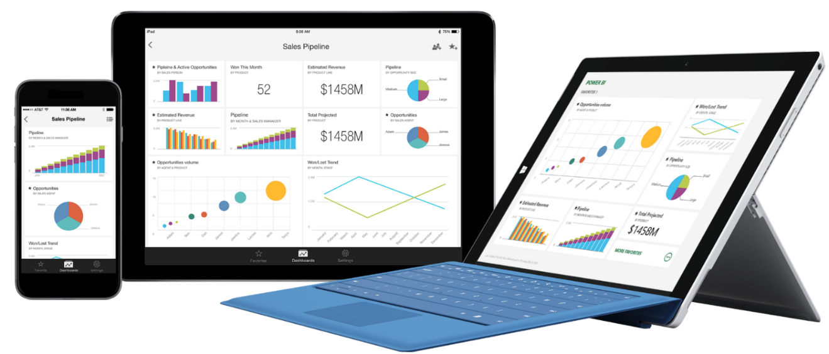
Stay connected from any device
Native apps for iPad, iPhone, and Windows devices
Receive alerts to important changes in your data
Share and collaborate with colleagues and take action

Slide 22
Session summary

Slide 23

Session objectives
Position Power BI added value
Provide an overview of the new Power BI experience
Provide an end-to-end Private Cloud example
Demonstrate power of Power BI for business

Slide 24
Resources – Getting started
Power BI service: https://powerbi.Microsoft.com
Documents, blogs and community links
https://support.powerbi.com
Microsoft Office getting started guides: https://support.office.com/en-IN/article/Power-BI-Getting-Started-Guides-bd30711a-7ccf-49e8-aafa-2e8f481e675d

Slide 25




















Thanks To All Our Sponsors

Slide 26
We Need Your Feedback
SCU Europe session planner [planning.systemcenteruniverse.ch]
SCU Europe WP app
Watch out for a survey invitation after the conference

